Slide 1
How AI is doing with respect to sympathy, agency, intention, meta-cognition, self-criticism, self-awareness, anthropomorphic embedding, personality, dreaming, prosthetic sentience, and what it is like to be Steph Curry
Ronald P. Loui, Ph.D.
Department of Computer Science
University of Illinois
Springfield
THE SCIENCE OF CONSCIOUSNESS
Designing a Conscious Robot: April 25-30, 2016 - Tucson

Slide 2
Because consciousness {C} could be about many different things …

Slide 3
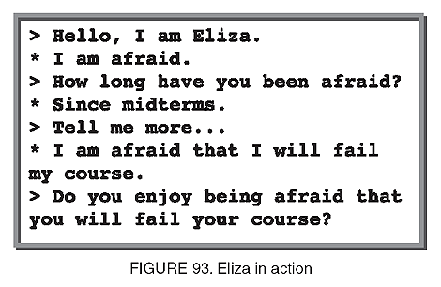


Sympathy
THEN: Eliza?
NOW: Facebook auto-reply?

Slide 4

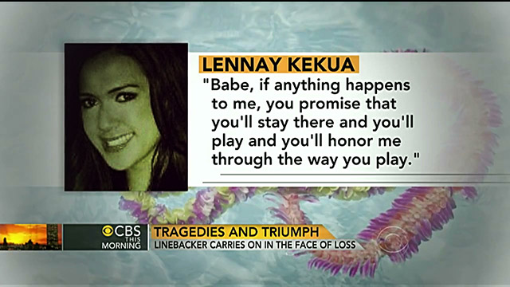
Sympathy
EDGE1: Manti Teo?
EDGE2: Tamagotchi?

Slide 5
Sympathy
Experience/sympathy information providing system
K Yoshida - US Patent 6,782,409, 2004 - Google Patents
... Upon receiving a request for preparing a recommended CD list in Step S71, the experience/sympathy information providing server stores the member ID of the user requested a recommended CD list as remarkable member in Step S72. ... Cited by 94
WATCH1: Text generation and classification
Evaluating an automated mental health care system: making meaning of human–computer interaction
R Farzanfar, S Frishkopf, R Friedman… - Computers in Human Behavior …, 2007 - Elsevier
... The fliers and advertisement addressed patients diagnosed with depression and invited them to use and evaluate an automated telephone system “designed to help ... said that she didn't like the phrase, “I am sorry”; it was more of a cliché than a real expression of sympathy. ...
Cited by 14
Emotion detection in suicide notes
B Desmet, V Hoste - Expert Systems with Applications, 2013 - Elsevier
... was mostly focused on manual analysis and detection of such features, eg by relying on techniques from discourse analysis (Clues to Suicide, 1957) or ... We observe a recent tendency to also rely on automatic corpus analysis techniques for the detection of suicidal messages. ...
Cited by 21

Slide 6
Sympathy
A design methodology for expressing emotion on robot faces
M Shayganfar, C Rich, CL Sidner - Intelligent Robots and Systems …, 2012 - ieeexplore.ieee.org
Abstract—We have developed a systematic methodology for designing emotional facial expressions for humanoid robots, especially those with limited degrees of freedom. The methodology is firmly grounded in the psychological literature on human static and ... Cited by 8
WATCH2: Faces (e.g., on robots, avatars, cgi)
Face recognition in the virtual world: Recognizing Avatar faces
RV Yampolskiy, B Klare, AK Jain - Machine Learning and …, 2012 - ieeexplore.ieee.org
Abstract—Criminal activity in virtual worlds is becoming a major problem for law enforcement agencies. Forensic investigators are becoming interested in being able to accurately and automatically track people in virtual communities. In this paper a set of ...
Cited by 12

Slide 7
Is sympathy necessary or sufficient for {C}? Is it too easily projected upon artifacts, hence attributed (like other minds)? NEXT: multi-modal bidirectionality in real-time?

Slide 8



Agency
THEN: Automatic control?
NOW: Automated espionage?

Slide 9

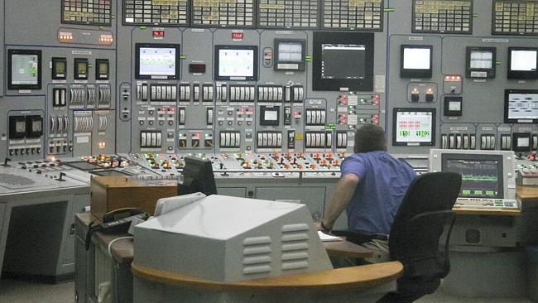
Agency
EDGE1: Siri
EDGE2: Nuclear power plant control

Slide 10
Agency
Unmanned surface vehicles-game changing technology for naval operations
SJ Corfield, JM Young - IEE CONTROL ENGINEERING SERIES, 2006 - books.google.com
... An advanced semi-autonomous mode allows USV operators to interact at a high level with remote USV drones while making a significant ... More than justa remote possibility: USVs enter the fray, Janes Navy International ... 8–11 Naval Surface Warfare Centre Cited by 48
WATCH1: Agents moving into the physical world
Editors and editing of anti-DNA receptors
H Li, Y Jiang, EL Prak, M Radic, M Weigert - Immunity, 2001 - Elsevier
... Immunity Immunity. Volume 15, Issue 6, December 2001, Pages 947–957. Editors and Editing of Anti-DNA Receptors. ... However, acidic IEPs of CDRs do not necessarily qualify Vκs for editing anti-DNA. ... Cited by 164

Slide 11
Agency
How google's self-driving car works
E Guizzo - IEEE Spectrum Online, October, 2011 - 123seminarsonly.com
Once a secret project, Google's autonomous vehicles are now out in the open, quite literally, with the company test-driving them on public roads and, on one occasion, even inviting people to ride inside one of the robot cars as it raced around a closed course. Cited by 13
WATCH2: consumer products
System and method for performing automatic spread trading
AKII Gary, JU Schluetter, M Burns, S Singer… - US Patent …, 2008 - Google Patents
The present embodiments are provided to facilitate the automatic trading of spreads in a fast and accurate manner. One or more market data feeds that contain market information for tradeable objects are received at an exchange. A spread data feed is generated in ... Cited by 194

Slide 12
Is agency necessary or sufficient for {C}? Clearly automata can have agency without {C}, but {C} without agency is comatose. NEXT: Optimality → abdication of decision, but not oversight responsibility!

Slide 13

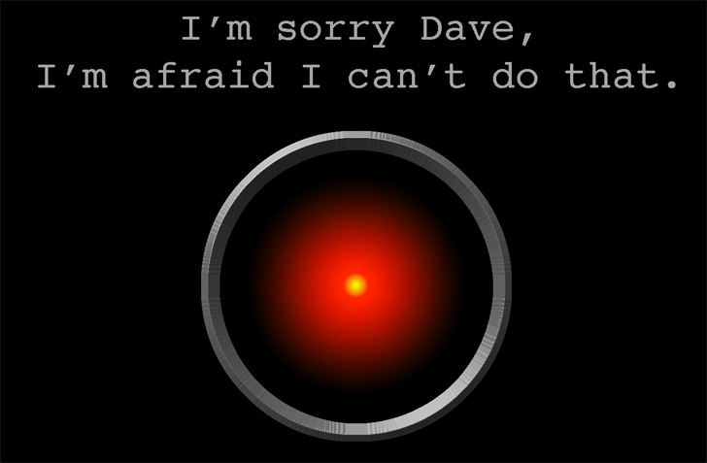
Intention (not accident, not rote, chosen)
THEN: HAL?
NOW: search → choice
NOW: mental states = BDI NOW: risk analysis process = robot’s mens rea

Slide 14
Intention
A plan recognition model for subdialogues in conversations
DJ Litman, JF Allen - Cognitive science, 1987 - Elsevier
Previous plan-based models of dialogue understanding have been unable to account for many types of subdialogues present in naturally occurring conversations. One reason for this is that the models have not clearly differentiated between the varoius ways that an ... Cited by 540
EDGE1: Understanding intention
Concurrent Plan Recognition and Execution for Human-Robot Teams.
SJ Levine, BC Williams - ICAPS, 2014 - aaai.org
Abstract There is a strong demand for robots to work in environments, such as aircraft manufacturing, where they share tasks with humans and must quickly adapt to each other's needs. To do so, a robot must both infer the intent of humans, and must adapt accordingly. ...
Cited by 17

Slide 15
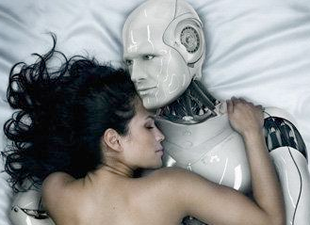
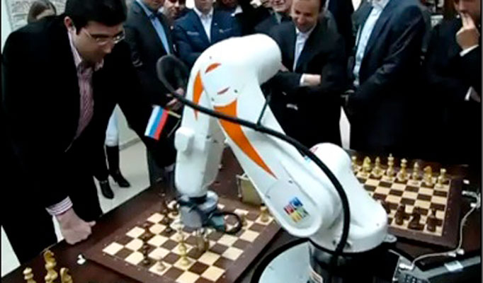
Intention
EDGE2: Constrained purpose → Programmed-intention + autonomous-sub-intention (e.g., intending to castle, intending to sacrifice,
intending
specific
tactic)?

Slide 16
Intention
Five years of implementation of China's Anti-Monopoly Law—achievements and challenges
X Wang, A Emch - Journal of Antitrust Enforcement, 2013 - antitrust.oxfordjournals.org
... Overall, the Anti-Monopoly Bureau has a staff of around 30 officials or more ... the decision to impose additional requirements on the companies—unless MOFCOM's intention was to ... Two well-known juice brands, 'Minute Maid' and 'Huiyuan,' increasing the company's control over ... Cited by 4
WATCH1: corporate intention
Multi-agent based hierarchical hybrid control for smart microgrid
CX Dou, B Liu - Smart Grid, IEEE Transactions on, 2013 - ieeexplore.ieee.org
... Architecture of hierarchical multi-agent based on hybrid control system. ... And the deliberative layer that is defined as “belief, desire and intention” has high intelligence of controlling or planning the behaviors of agent so as to achieve its desire or intention. ... Cited by 54

Slide 17
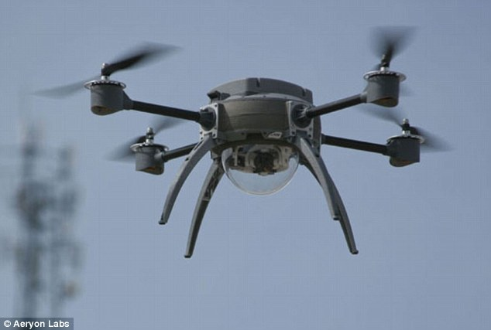


Intention
WATCH2: Law regarding consumer automation and treaties regarding autonomous weapons

Slide 18


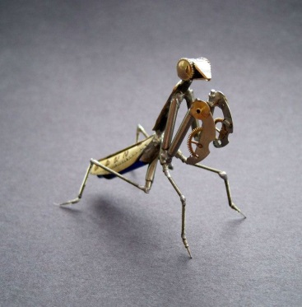
Intention
Embodied agents for multi-party dialogue in immersive virtual worlds
D Traum, J Rickel - … international joint conference on Autonomous agents …, 2002 - dl.acm.org
... of the adequacy of agents using this model to participate in complex conversational interactions ... and extends prior work on spoken dialogue and embodied conversational agents, providing a ... the core portions of our dialogue model, integrated into an embodied agent with a ... Cited by 261
WATCH3: Complex, learned, diverse tactic selection in virtual worlds (cognition) and/or
Bio-philic/-morphous sensori-motor choices in physical worlds (attribution)

Slide 19
Is intention necessary or sufficient for {C}? Intention required for conscious agency. NEXT: More B-D-I control architectures will make it hard not to attribute intention, which was part of the design. But “intention toward” in a referential sense? Is that a matter of being embedded in the physical world (or virtual world for intention toward profit, configuration, angry bird trajectory, etc.)?

Slide 20

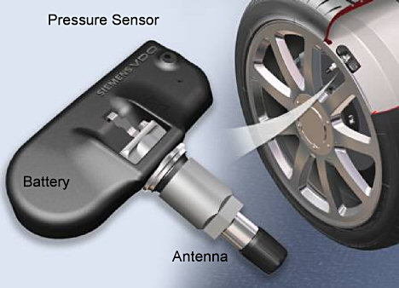

Meta-cognition / Self-criticism
THEN: Bayesian value of information calculation
NOW: Autonomous, unsupervised learning, argument/belief revision,
Monitoring sensors for accuracy/alignment

Slide 21

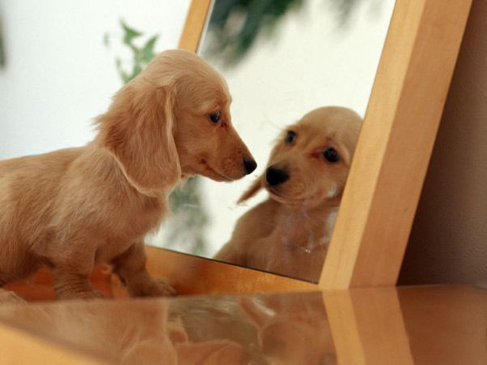

Meta-cognition / Self-criticism
Robots With Internal Models A Route to Machine Consciousness?
O Holland, R Goodman - Journal of Consciousness Studies, 2003
EDGE1: Self-awareness: “That feeling you get”
Should empathic social robots have interiority?
L Damiano, P Dumouchel, H Lehmann - Social Robotics, 2012

Slide 22

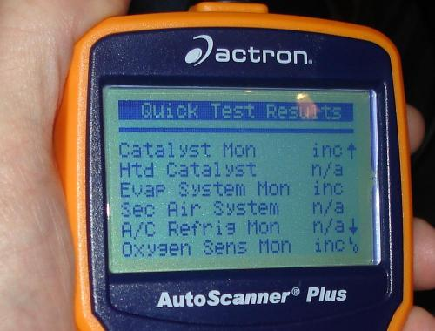
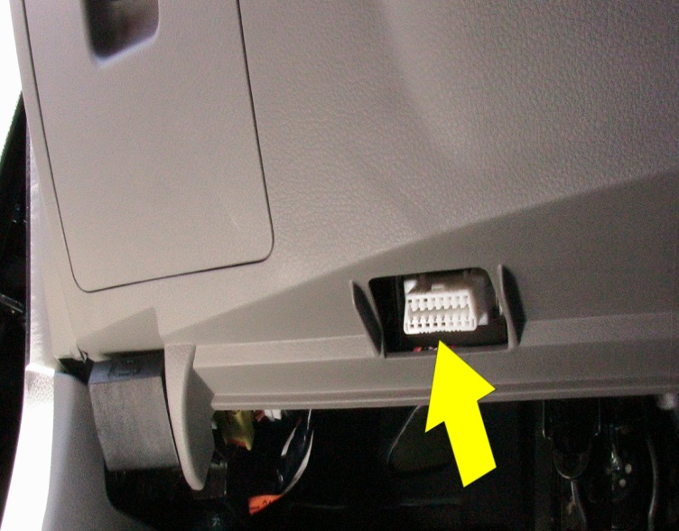
Meta-cognition / Self-criticism
EDGE2: Supervisory
and Diagnostic
parallel processes and analytics

Slide 23
Meta-Cognition / Self-Criticism
Self-Monitoring Cluster of Network Security Devices
T Linden, J Huang, J Hsu, MJ Lee - US Patent App. 12/643,548, 2009 - Google Patents
A computing device may be joined to a cluster by discovering the device, determining whether the device is eligible to join the cluster, configuring the device, and assigning the device a cluster role. A device may be assigned to act as a cluster master, backup master, ... Cited by 28
WATCH1: Security
Information-theoretic measures for anomaly detection
W Lee, D Xiang - Security and Privacy, 2001. S&P 2001. …, 2001 - ieeexplore.ieee.org
Abstract Anomaly detection is an essential component of the protection mechanisms against novel attacks. In this paper; we propose to use several information-theoretic measures, namely, entropy, conditional entropy, relative conditional entropy, information gain, and ...
Cited by 569

Slide 24
Meta-Cognition / Self-Criticism
WATCH2: Argument (internal, not just social)
A general account of argumentation with preferences
S Modgil, H Prakken - Artificial Intelligence, 2013 - Elsevier
... 34]; S. Modgil, M. Caminada; Proof theories and algorithms for abstract argumentation frameworks. I. Rahwan, G. Simari (Eds.), Argumentation in AI, Springer-Verlag (2009), pp. 105–129. ... Cited by 112
A dialectic procedure for sceptical, assumption-based argumentation.
PM Dung, P Mancarella, F Toni - COMMA, 2006 - argument-act.googlecode.com
... 0≤ i< n, only one σ in Pi or one S in Oi or one S in Fi is selected, and: 1. If σ∈ Pi is selected then (i) if σ is an assumption, then Pi+ 1= Pi−{σ} Ai+ 1= Ai Ci+ 1= Ci Oi+ 1= Oi∪{{σ}} Fi+ 1= Fi PM Dung et al./ADialectic Procedure for Sceptical, Assumption-Based Argumentation 152 ... Cited by 95

Slide 25
But what is self-awareness? It is the feeling of meta-cognition, not just the act of meta-cognition! Are plants self-aware? NO Are birds self-aware? ALMOST CERTAINLY How much architecture needed for internal feeling, or internal feeling ascriptions? Can a sex-robot be embarrassed? “Self-conscious”? (it can clearly act that way)

Slide 26

That Self-Aware Feeling
What is it like to be pleased by a man?
Which man?
This morning or this evening?
At the end? Or at the start, twenty seconds earlier?
I generally find men displeasing.

Slide 27
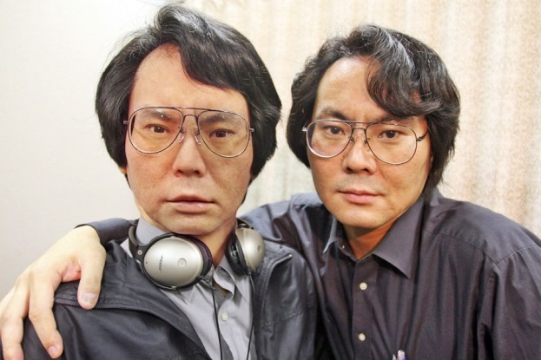
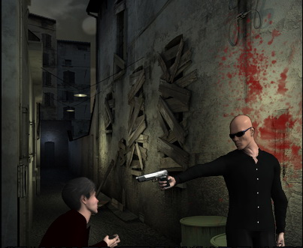

Anthropomorphic Embedding, Personality, and Dreaming
THEN: Disney
NOW: Better packaging and physical embedding
Architectures designed with personality
or designed to freely associate possibly episodically with creative reference
Min-constraint

Slide 28

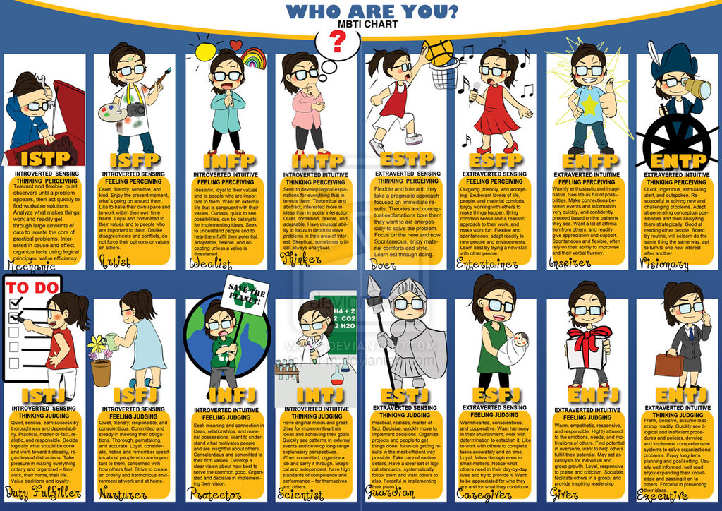
Anthropomorphic Embedding, Personality, and Dreaming
WATCH1: Rise of MBTI and believable agents in games
Personality-driven social behaviors in believable agents
P Rizzo, M Veloso, M Miceli, A Cesta - … on Socially Intelligent Agents, 1997 - aaai.org
Agents are considered" believable" when they are viewed by an audience as endowed with thoughts, desires, and emotions, typical of different personalities. The paper describes our work in progress aimed at reaiizing believable agents that perform helping ... Cited by 66

Slide 29

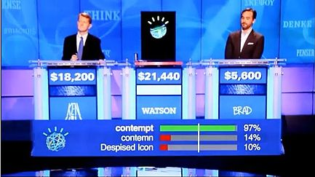

Anthropomorphic Embedding, Personality, and Dreaming
WATCH2: associative-memory-based classifiers

Slide 30
Like most of these, anthropomorphism + proper embedding + BDI+argument-based (human-inspired) control → ready attribution

Slide 31


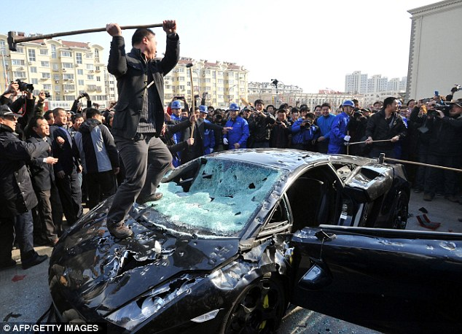
Prosthetic Sentience
THEN: “Poor machine!”
NOW: Plugged-in Humans, crowd-sourced responses

Slide 32


Prosthetic Sentience
EDGE1: Lacrimonious Lagomorphs

Slide 33



Prosthetic Sentience
EDGE2: Multi-player online games, and
computer-mediated asynchronous, semi-automatically generated human interaction

Slide 34
Most think the sentience has to be built into the robot… But perhaps the robot is being built around the sources of sentience.

Slide 35

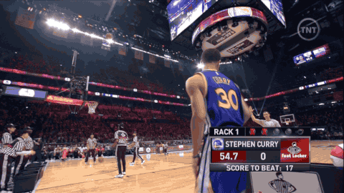

But what about {C}?
What is it like to be conscious?
What is it like to be
“Un-conscious”?
http://sports.cbsimg.net/images/visual/whatshot/120214_CurryWinner2.gif
https://www.youtube.com/watch?v=6ap2CA8Z58M
http://s3.amazonaws.com/br-cdn/temp_images/2015/02/15/2015-02-1419_01_08.gif

Slide 36

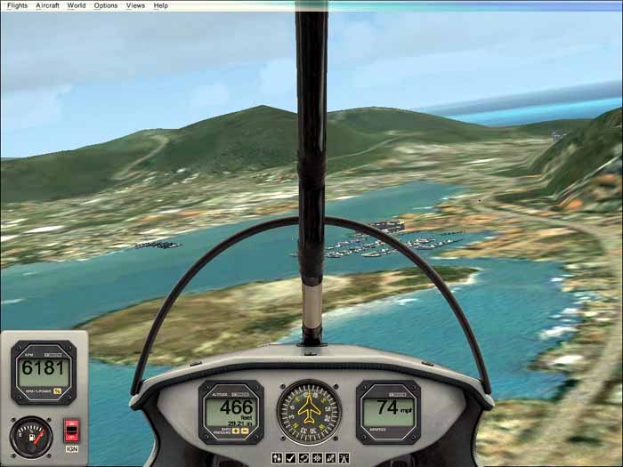
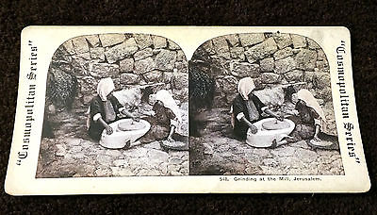
What is it Like to BE Steph Curry (when his shooting is “unconscious”)?
THEN: Immersive fiction, photos, film, graphics
NOW: Immersive simulators, first-person perspective, VR, NBA 2K

Slide 37




So I can feel like Steph Curry, but can a computer (system)?
Can Steph Curry always feel like Steph Curry?
Start SMALL: Can a system
feel right? Right as rain? Feel Good like it knows that it Should?
“Feel the Noize”?

Slide 38
Instrumentally, of course. A computer (system) can exhibit behaviors as-if it felt the noize. Internally, of course not. Not until either the predicate is weakened (e.g., legal or linguistic reform), or until the architectures include much more complex deep emotional state implementation. That’s possible, leading to feel/feel*. More likely, sentient beings will be co-opted for their internal states, one way or another.

Slide 39
What about {C}onsciousness? It seems to be many things. Prototypically, perhaps the imposition of episodic first-person feeling and awareness upon sensory here-and-now states. Progress on this is everywhere, but not feeling. But that too may be changing with consumer interest in “genuine” mammalian internal states, not merely ascriptions.

