Slide 1
An Ontology for Active and Passive
Aerial Drone Threat
Automatic Plan Recognition
Ronald P. Loui, Ph.D. and Josh Smith
Department of Computer Science
University of Illinois
Springfield, IL
r.p.loui@gmail.com

Slide 2
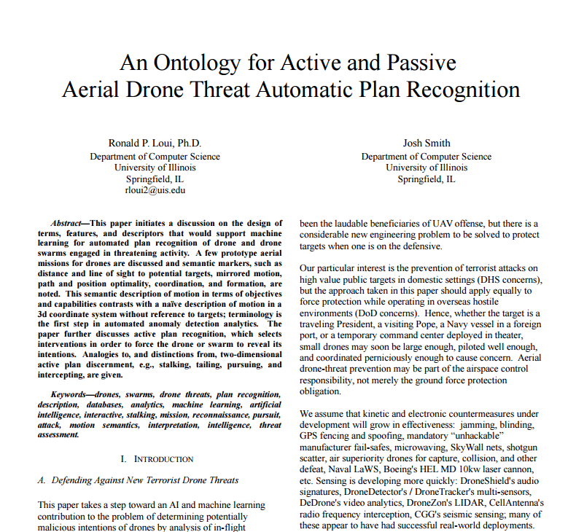

Slide 3
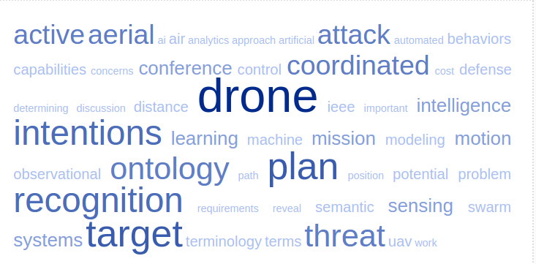

Slide 4


IEEE EIT 2016
IEEE ICCST 2016

Slide 5
An Ontology
for Active and Passive
Aerial Drone Threat
Automatic Plan Recognition
Ronald P. Loui, Ph.D. and Josh Smith
Department of Computer Science
University of Illinois
Springfield, IL
r.p.loui@gmail.com

Slide 6
Aerial Semi-Autonomous Agile Asymmetric Threats
Offense favoring
Low cost / low tech / + multiagent coordination
Hard to sense / ban / defeat
Growing capability
  Payload
  Prevalence
  Multimodal guidance: GPS, real-time vision, pre-programmed vision, laser, etc.

Slide 7
How to defend against it?
We assume the good guys have high tech
We assume sensing will soon be pretty good
  DroneShield auditory
  DeDrone visual
  CellAntenna radio
  DroneZon LIDAR
We assume defeat will eventually get there

Slide 8
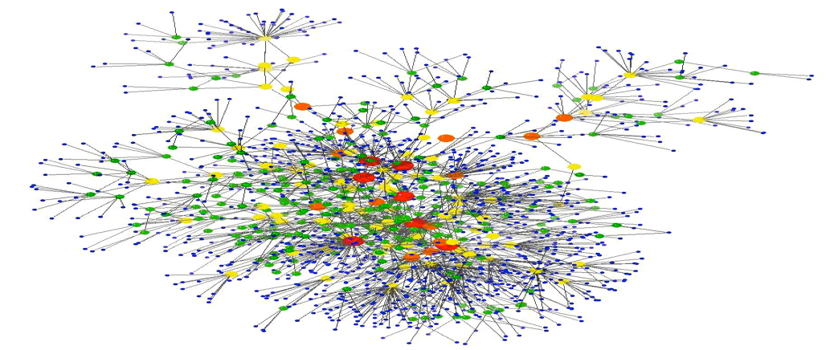
How Can AI Help?
Sensor Fusion
Plan / Intention / Threat Recognition
Machine Learning / Uncertain Reasoning
Need an Ontology of Drone Activity

Slide 9
Most Important Point
Choosing an algorithm isn't going to help much without the right terminology
Garbage in = Garbage out
Wrong Big Data = Big Useless Data
You can't reason about it if you can't express it
  Even emergent concepts require the right inputs
  Nothing wrong with helping the AI find the right stuff

Slide 10
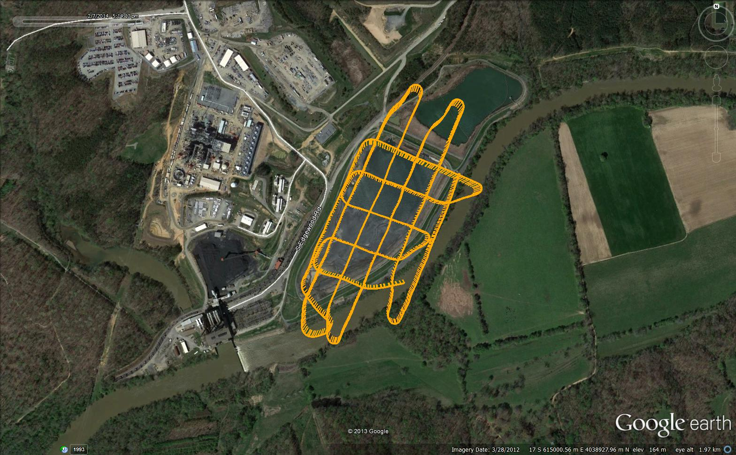
What is this Drone Doing?

Slide 11
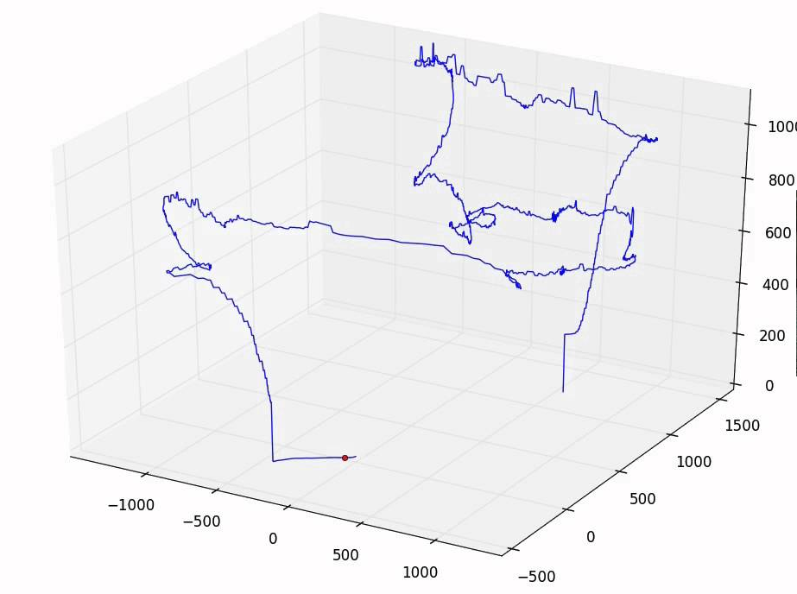
What is this Drone Doing?

Slide 12
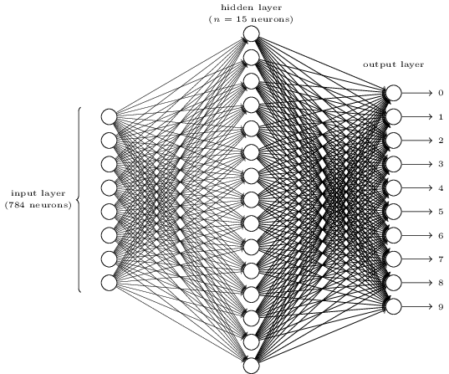
Won't AI/Magic Tell Me?
THREAT
NOT A THREAT
More training? More nodes?

Slide 13
What is this Drone Doing?

Slide 14
What is this Drone Doing?

Slide 15
Capture Data In Terms of Target
Domain Modeling / Terminology / Vocabulary / Data Description / Primitives / Input Layer / Relevant Concepts … whatever you want to call it

Slide 16
Capture Data In Terms of Target
Maintains-line-of-sight
Responds-to-target-ambiguity-with-choice-hesitation
Responds-to-blocking-with-vector-to-target-correction
Deviates-from-others-on-site

Slide 17
Terminology w.r.t. Mission
A. Reconnaissance
  Maintains-line-of-sight
  Maintains-watchful-min-distance-and-max-distance
  Matches-changes-in-motion
  Responds-to-blocking-with-angular-deviation
  Responds-to-sensory-obscuration
  Responds-to-target-concealment
  Exhibits-ground-survey-pattern
  Follows-target-intermittently
  Time-spent-in-proximity-of-target

Slide 18
Terminology w.r.t. Mission
B. Attack
  Maintains-minimum-distance
  Maintains-altitude
  Maintains-straight-line-clear-path
  Follows-target-constantly
  Responds-to-blocking-with-robust-deviation
  Responds-to-target-ambiguity-with-choice-hesitation
  Exhibits-load-bearing-dynamics

Slide 19
Terminology w.r.t. Mission
C. Intercept
  Accelerates-to-vector-to-target
  Approaches-constantly
  Approaches-quickly
  Dives
  Responds-to-blocking-with-vector-to-target-correction
  Responds-to-target-ambiguity-with-hesitation
  Ignores-target-concealment

Slide 20
Terminology w.r.t. Mission
D. Coordination
  Maintains-formation
  Maintains-angle-or-distance
  Maintains-distance-to-target
  Exhibits-sudden-parallel-acceleration
  Exhibits-serialized-flight on-same-path
  Exhibits-mutual-statistical-anomaly-of-motion
  Exhibits-mutual-statistical-anomaly-of-configuration
  Marks-target

Slide 21
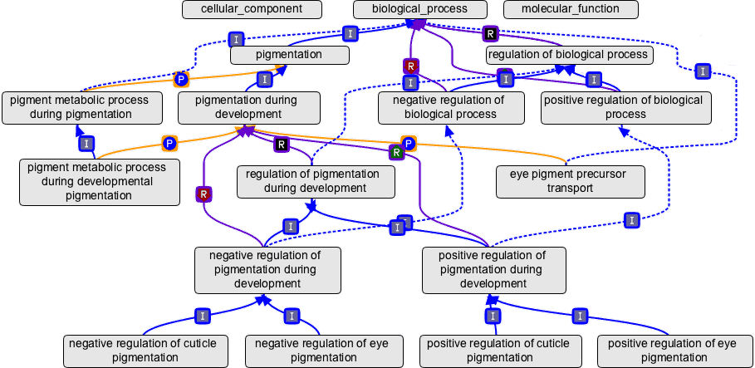
geneontology.org

Slide 22
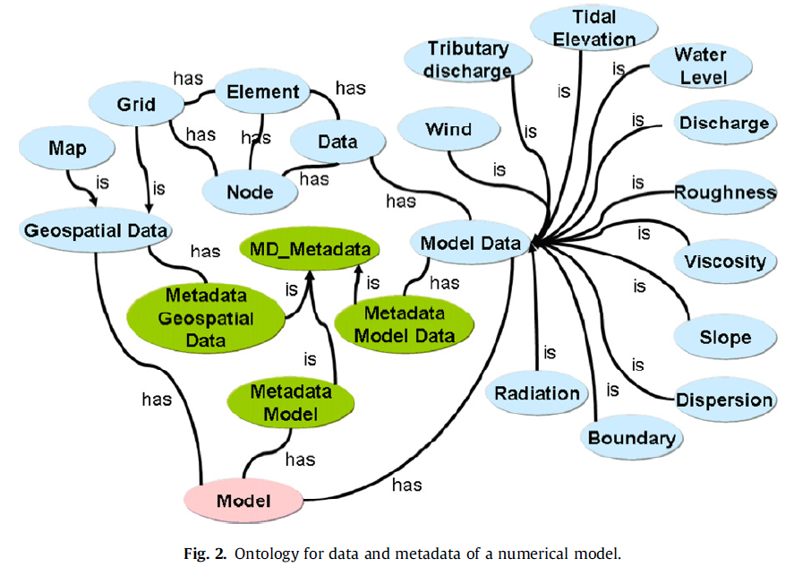
Islam, A.S.; Piasecki, M. (2008). Ontology based web simulation
system for hydrodynamic modeling.
Simulation Modelling Practice and Theory 16(7): 754-767.

Slide 23
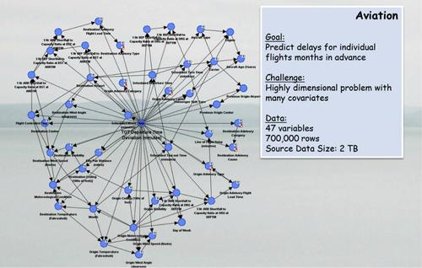
Booz Allen Bayes Net

Slide 24
Second Most Important Point
Not a 3d coordinate terminology
Observations in terms of CAPABILITY
Plan Rec is based on a plan library + constraint satisfaction
But even with soft constraints on behavior, thinking in terms of BDI (belief-desire-intention) gives the important concepts

Slide 25

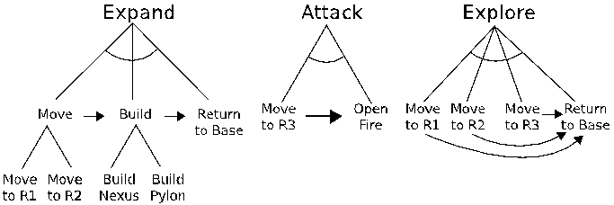

Slide 26
Second Most Important Point
Not a 3d coordinate terminology
Observations in terms of CAPABILITY
Plan Rec is based on a plan library + constraint satisfaction
But even with soft constraints on behavior, thinking in terms of BDI (belief-desire-intention) gives the important concepts
Active probing: Responses give information
  Ground-level concealment / ambiguity
  Air intercept / Occlusion / Interposing

Slide 27
Final Important Point
Why Care? Why Not Shoot Them All Down?

Slide 28
Final Important Point
Why Care? Why Not Shoot Them All Down?
Assessment / Intelligence = Early Warning
  Esp. against insider threats

Slide 29
Final Important Point
Why Care? Why Not Shoot Them All Down?
Assessment / Intelligence = Early Warning
  Esp. against insider threats
Multi-stage Attack
  Understanding = Proper Response
Due Diligence
  Ethical / Legal CYA

Slide 30
Final Important Point
Why Care? Why Not Shoot Them All Down?
Assessment / Intelligence = Early Warning
Multi-stage Attack
Due Diligence
Future Ambiguity / Crowded Skies / Mobile Targets

Slide 31
Summary
We Propose More Thought on
  Practical Semantically Relevant Ontology
  Active Revelation of Intentions
  Esp. Multi-Agent Multi-Modal Threats
Drone Behavior Analytics
r.p.loui@gmail.com

Slide 32



