Slide 1
Loui (UIS CSC) – Ghasemisharif (UIC CSC) – Salvador (UIS ITS) – Caughey (UIS CSC)
Virtualized
Dynamic Port Assignment
and
Windowed Whitelisting
for Securing Infrastructure Servers
IEEE EIT 2016
Ronald P. Loui

Slide 2

How to Protect a Server
Limit Accounts
  Know privileged users
  Know pattern of connections
Log Activity
Reduce Services
  close services-@-ports
Add Firewall Rules
  filter IP addresses-X-services-@-ports
Punt
  Move to the cloud and make it someone else's problem

Slide 3
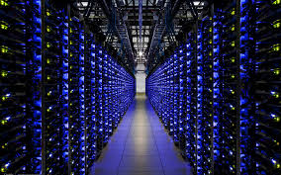
Infrastructure Servers
Specialized function
  Web servers / Application servers / Cycle servers
  Database servers / Mirrors / File servers / Proxy & Edge servers
  Authentication & Comm servers / SCADA control / IOT control
  Mail servers / Game servers / Print servers
Occasional access
  Not accessed by many privileged people
  Not accessed often by privileged people
  Running on autopilot / standalone mode

Slide 4
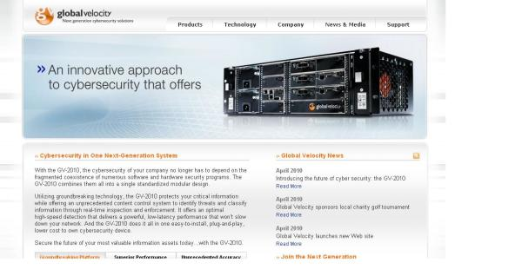
Antecedent Ideas
Deep Packet Inspection Firewall
  Rules for packet contents: patterns, byte restrictions / limits
  Byte frequency histograms
Data Loss Prevention
  Global Velocity, St. Louis
Improve DPI and DLP
  by segregating traffic
  e.g., cgi on specific ports
  e.g., no special characters
Also DPRW (FPSED)

Slide 5
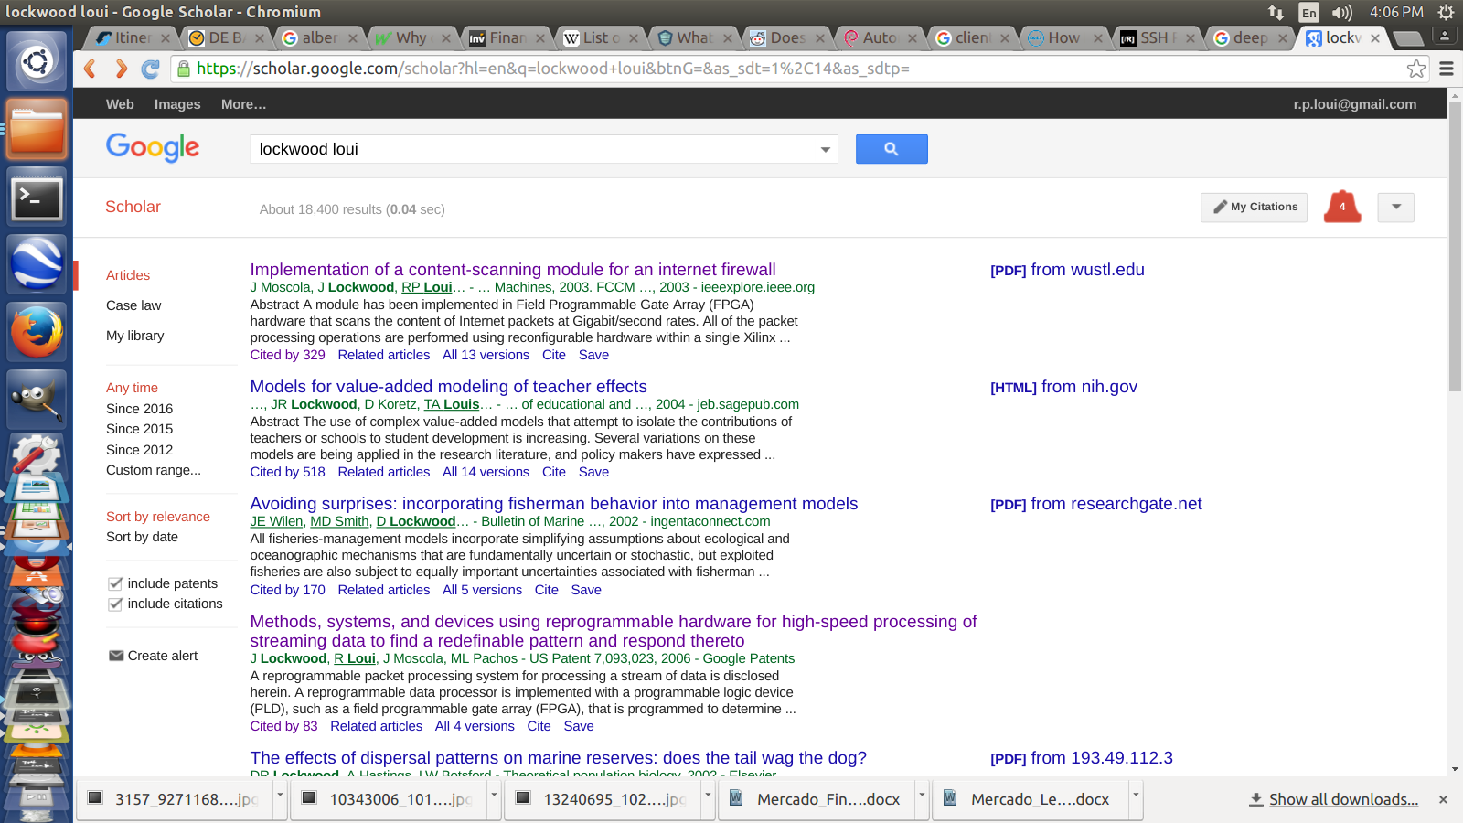

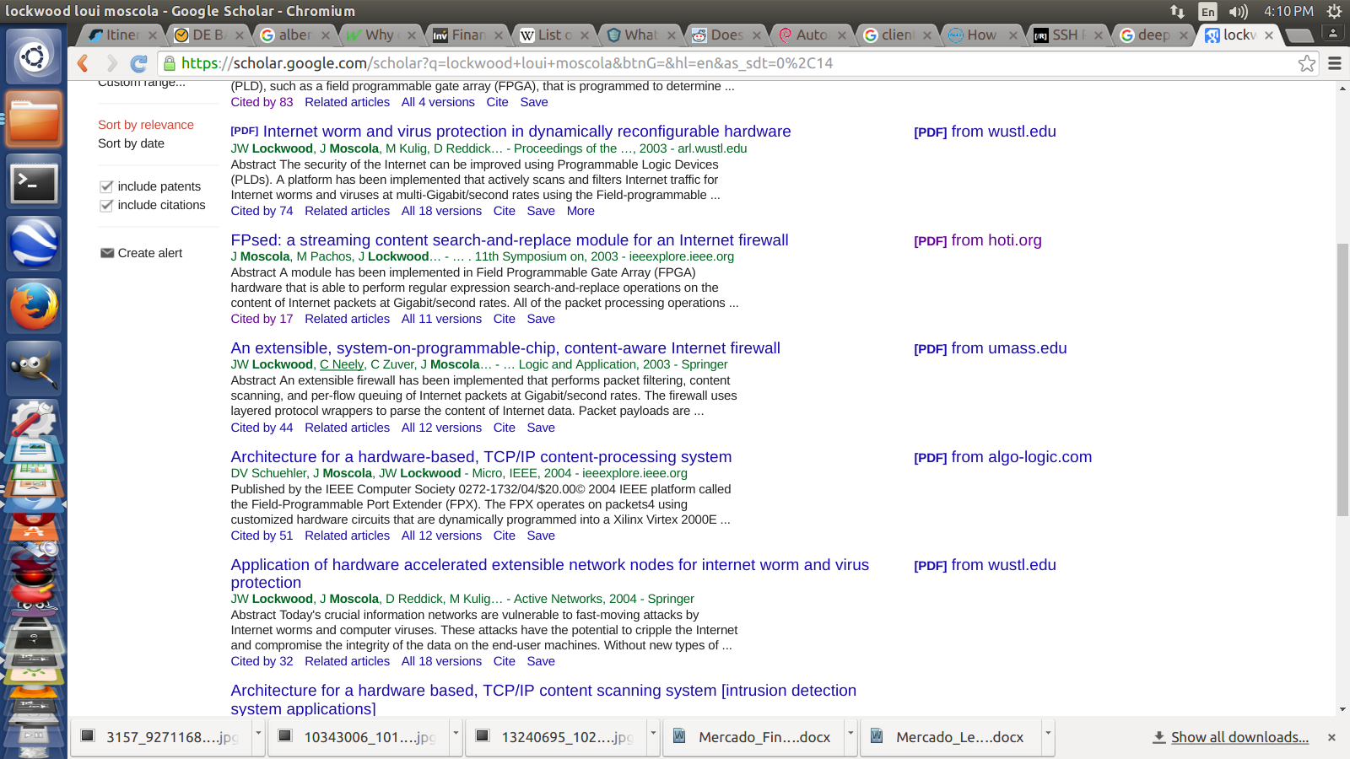

Slide 6


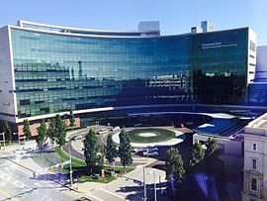
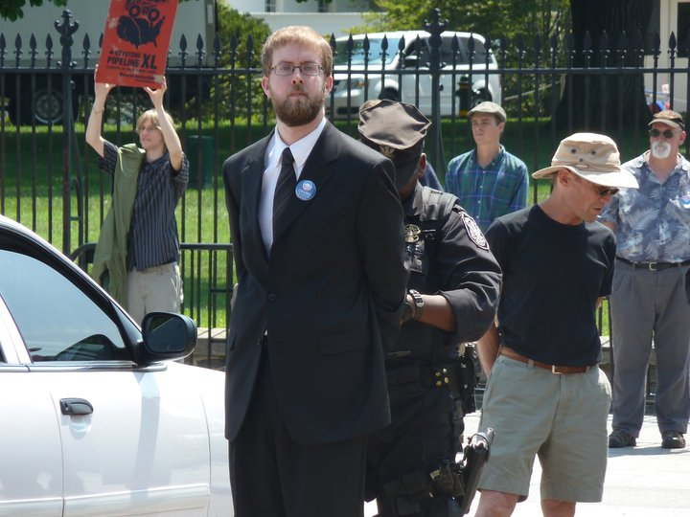
Antecedent Practices
Allen Reuter: WUSTL ITS
  „you can ssh through our web portal“ (web-based ssh on js/ajax)
John Clark: Cleveland Clinic Research Group
  „I put ssh on port 77 instead of 22“ (vs. script kiddies c. 2005)

Slide 7
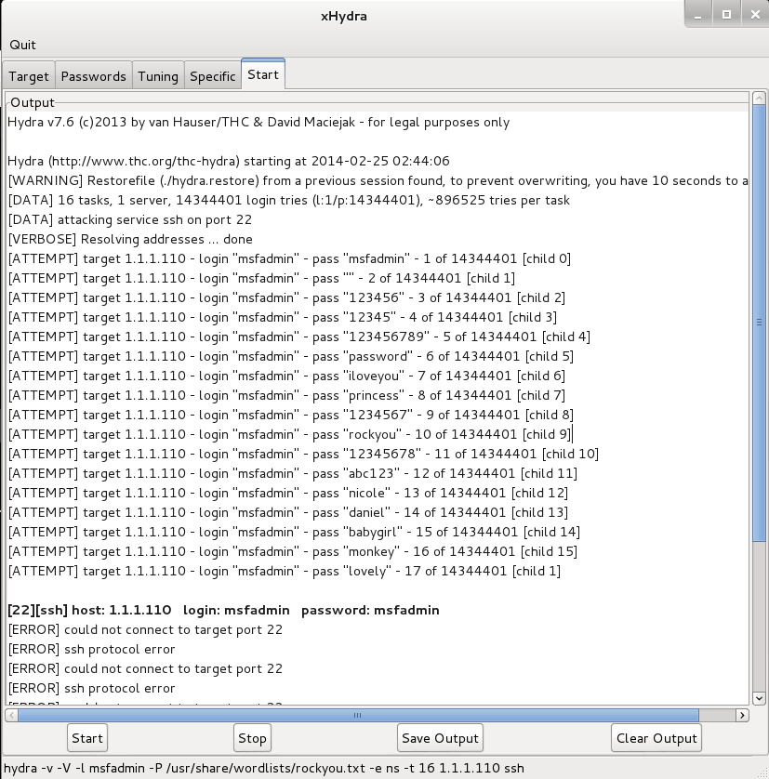
Acute Problem
UIS ITS uisacad servers inundated with ssh password guessing attacks
  DOS, even when unsuccessful
  Moved to VPN
    Introduces some privacy issues
    Employer split/tunnels employee data
    Not all clients can support VPN easily
  Could not whitelist?
    Unanticipated legitimate connections
    Management of accept/deny lists
    Listing errors / Timely access
    Many domains, dynamic IP
    IP spoofing attacks (internal mischief)
  Maybe there is a different, general solution

Slide 8
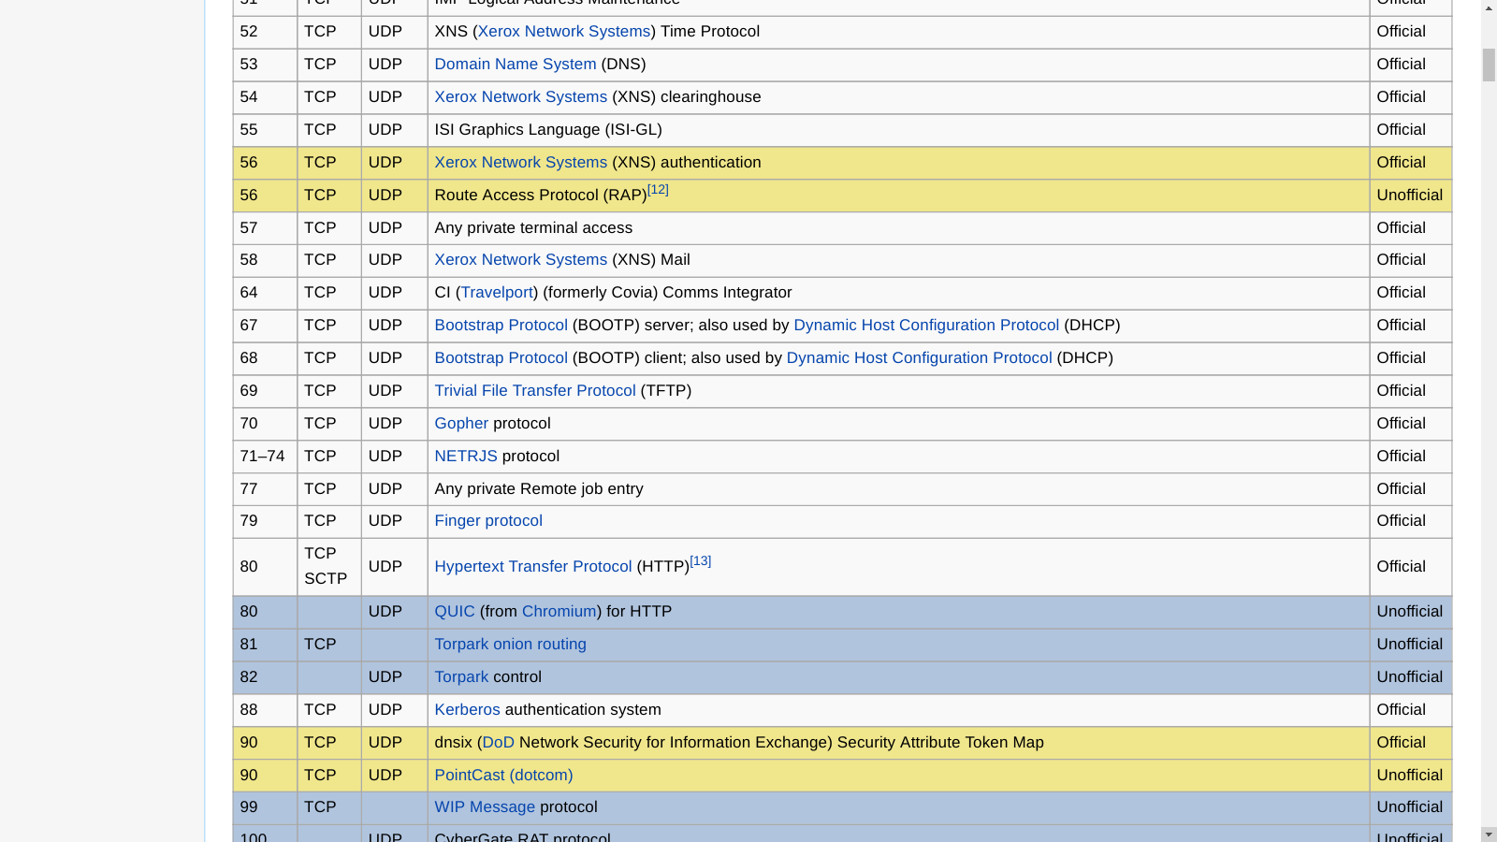
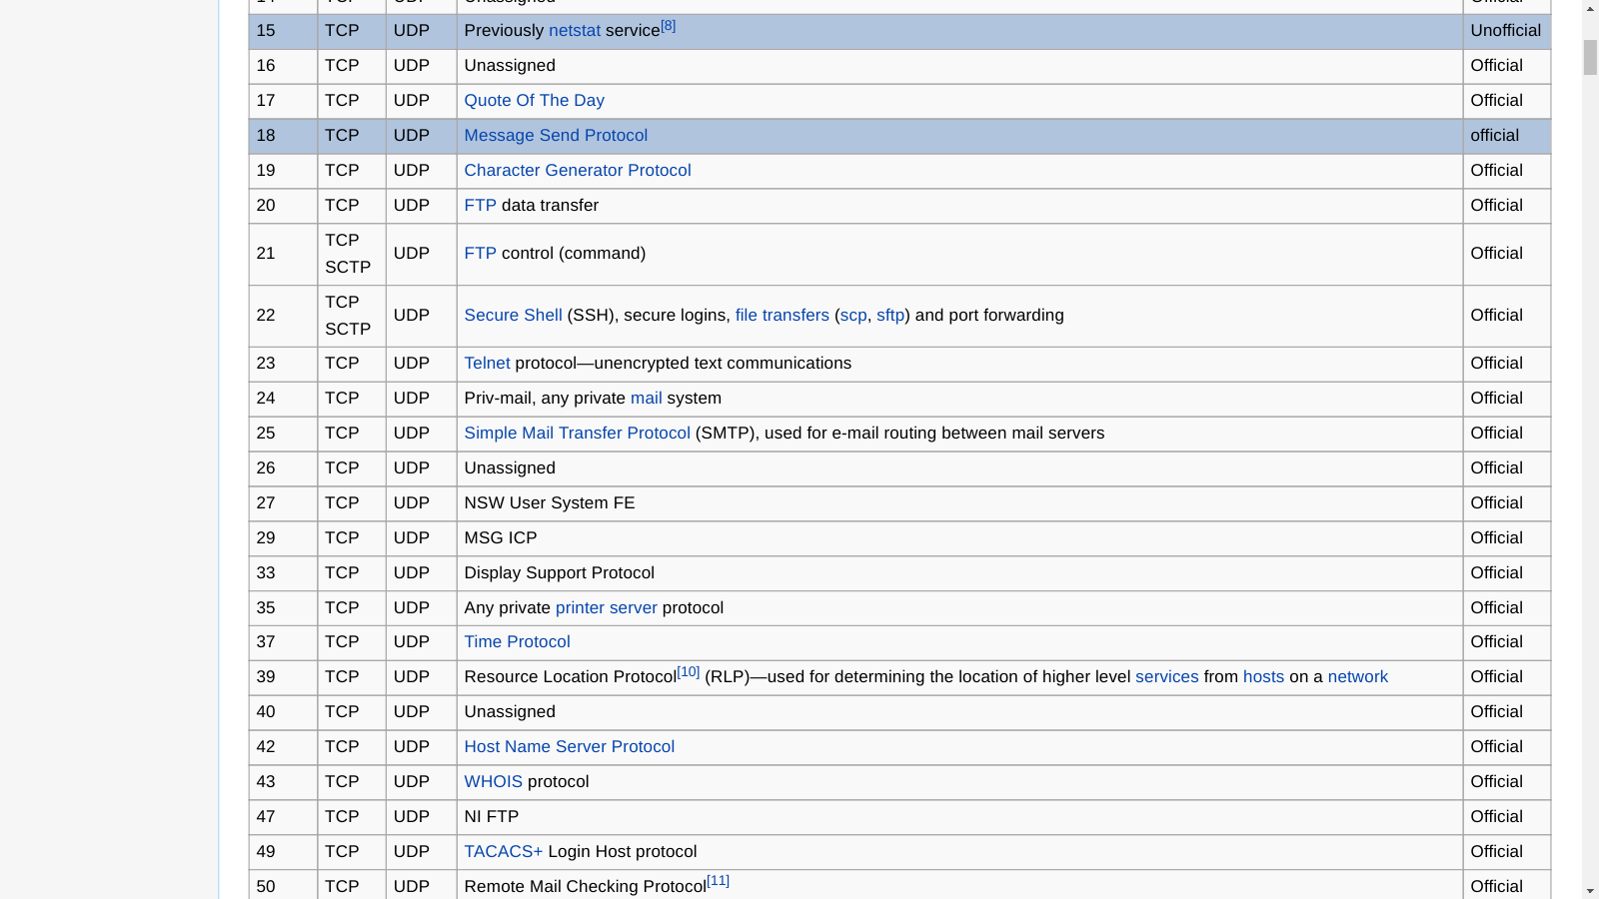

Slide 9
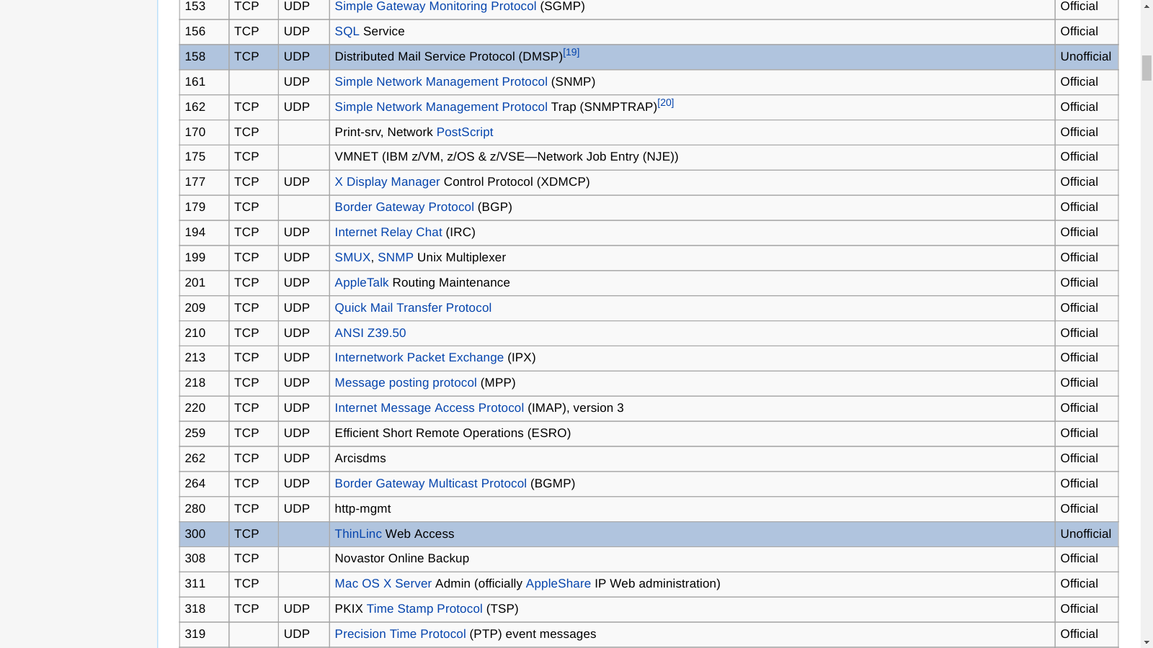
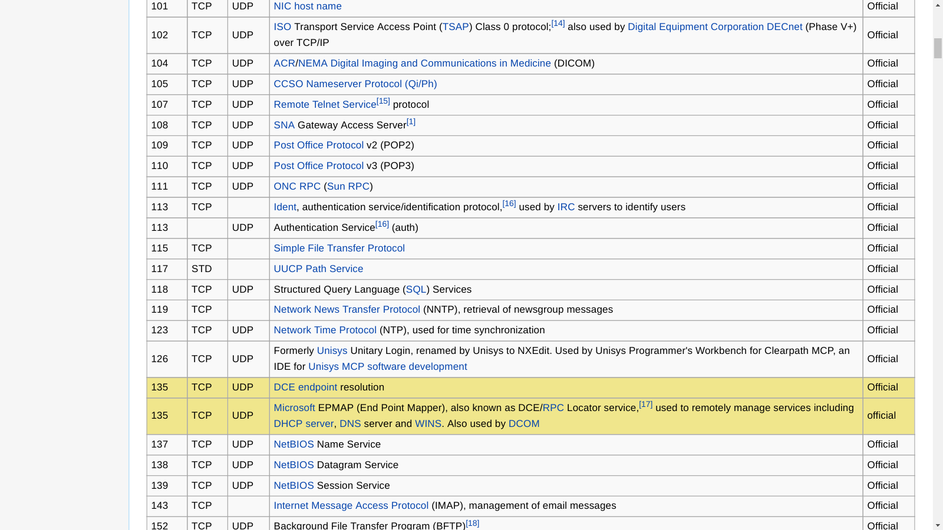
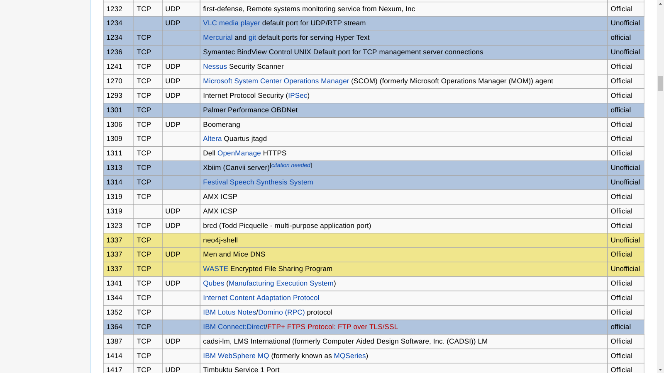

Slide 10
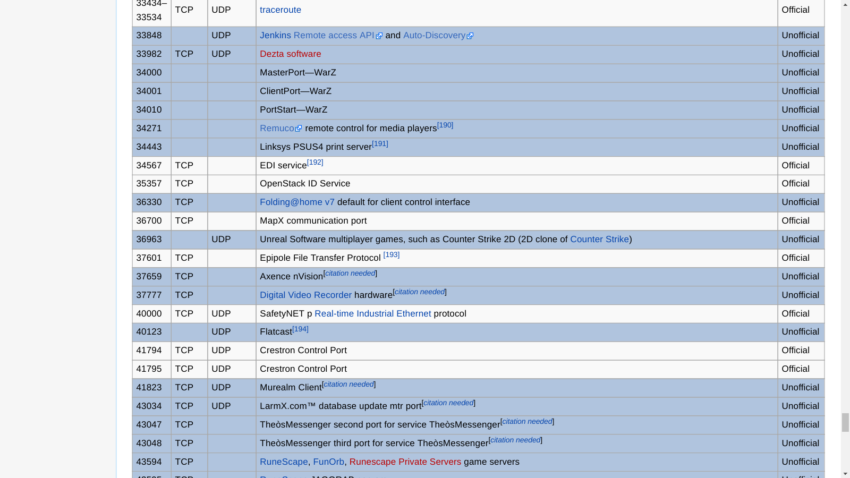

Slide 11
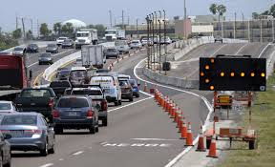
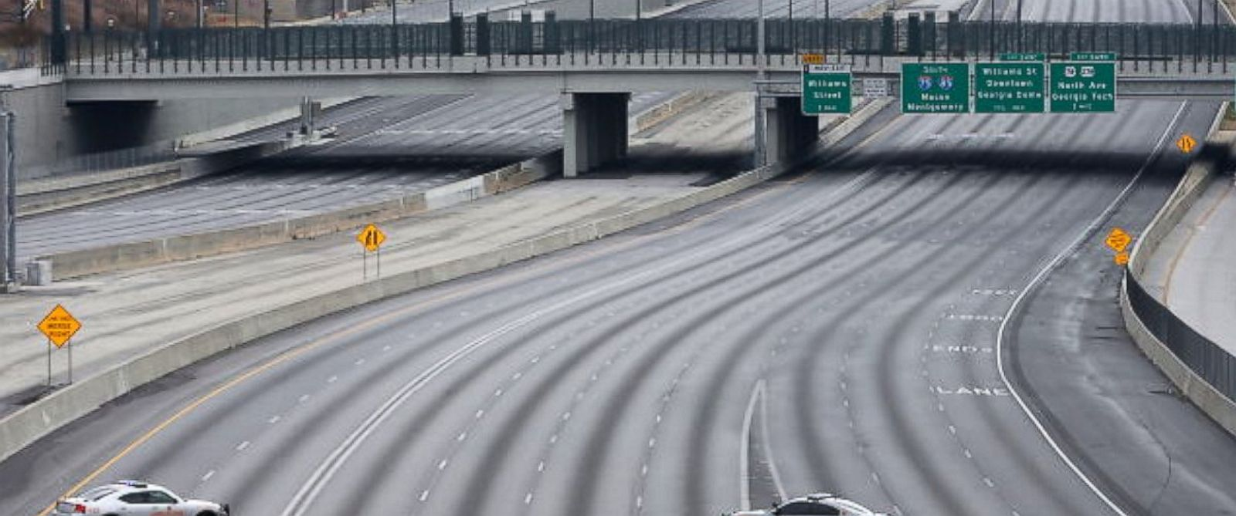
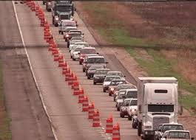
What a Terrible Waste of Ports
We end up closing down all but a few ports
Why allocate ports based on each app / .com?
  28960: Call of Duty
  35008: Jayson's Water Fun Connector
  4001: Microsoft Ants Game
  3645: Cyc
    Maybe more people should use this!
  1337: WASTE
    „In 2003, less than 24 hours after its release,
    WASTE was removed from distribution by AOL“

Slide 12

Our Idea: DPA + WW
Dynamic Port Assignment + Windowed Whitelisting
Assign services to non-standard ports
Vary the port assignment dynamically
Whitelist temporarily on demand
Authenticate and use https on known publication port
  modern layered, multi-factor
  wrapper for vulnerable services
Require users to declare their connection time limit in advance
Automatically remove from whitelist on disconnection/timeout
… More … (another paper „DFP“)

Slide 13
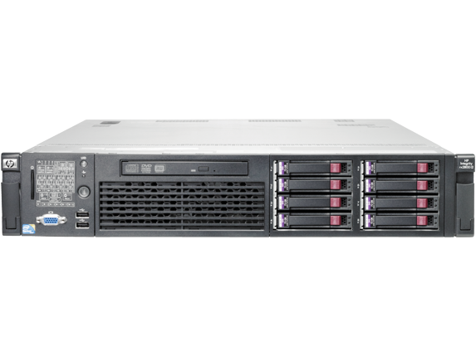
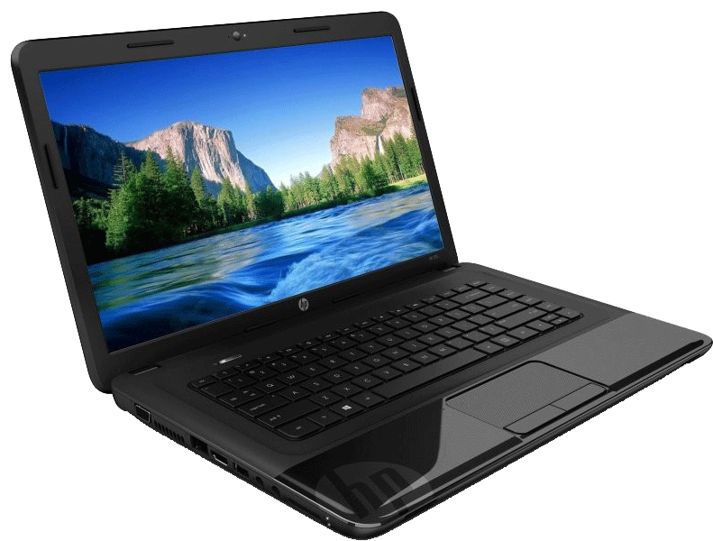
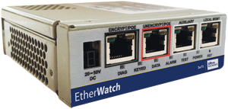
Our Idea: VDPA + WW
Virtual Dynamic Port Assignment + Windowed Whitelisting
Use virtual port forwarding so do not need to restart services
23 deny all
25917 for 13.2.3.14 59min
SSHD on 23
13.2.3.14

Slide 14
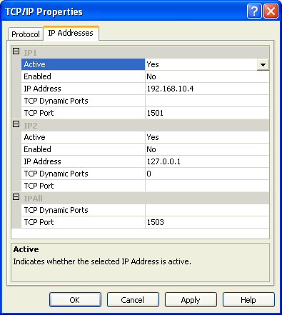
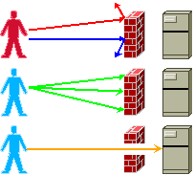
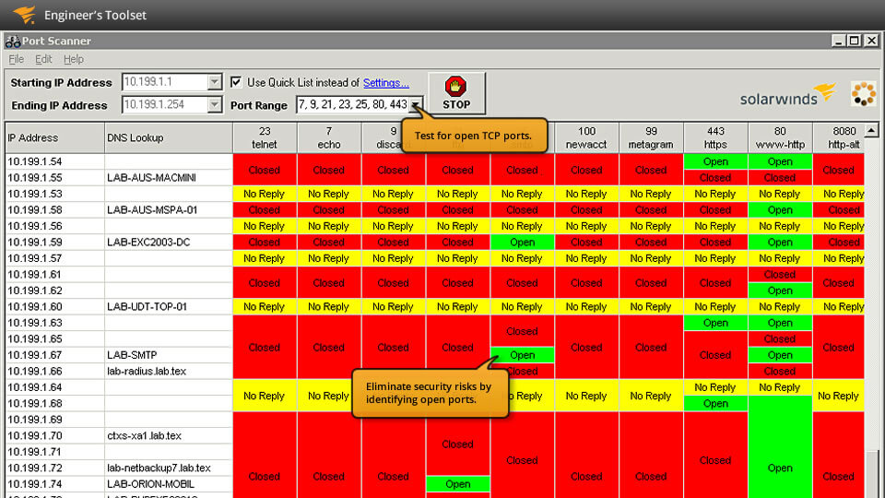
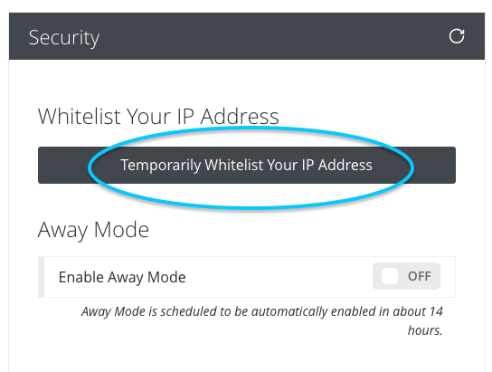
Advantages
Kiddie scripts can't find standard port
Port scanners can't find ssh service
No change to server configuration
Modest scripting:
  Port-generator & Wlist-manager run on firewall
  Can add any authentication at connection-manager
    Even to vulnerable legacy services
    Or when exploits not yet published
  Can add analytics at connection-time
IP-spoofing scanners have
  a large space to search
  in a short time (64k ports x IP range)
More „manual“ than port-knocking, port hopping

Slide 15
Our Idea: DPA + WW + DPI
Dynamic Port Assignment + Windowed Whitelisting
+ Deep Packet Inspection
Segregate traffic for improved content filtering
  More rules
  More specific rules
  More kinds of rules
23 deny all
25917 for 13.2.3.14 59min
/^[\w\s_]*$/ || ...
25999 for 31.4.159.2 40min
/^[^\x00]*$/
HTTPS/CGI on 2433
13.2.3.14
31.4.159.2

Slide 16
More Advantages
Anomaly detection at I/O
  Mitigate injection threats
    e.g., reject special characters, buffer overruns
  Limit data loss
    e.g., reject sql injection and probing
    e.g., stop large data transfers byIP-byService-byTime
    May help against rootkit and backdoor attacks, or rogue sysadmins
  … and more … (DFP paper)
Can separate dynamic web content at each dialogue stage
  Reduce probing of scripts at firewall
    Reduce downstream traffic
    External session control

Slide 17
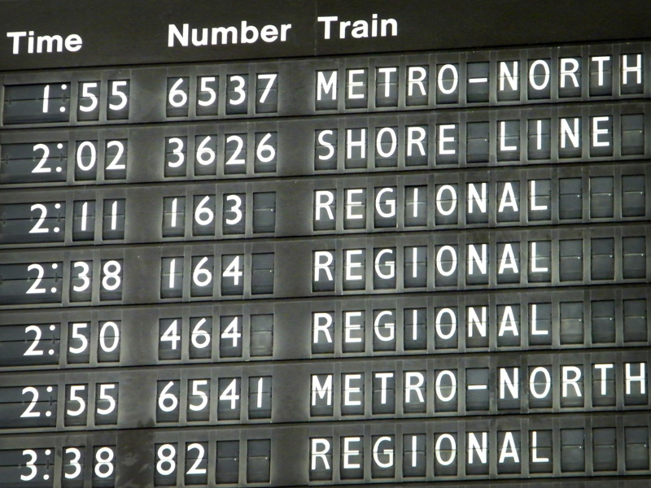
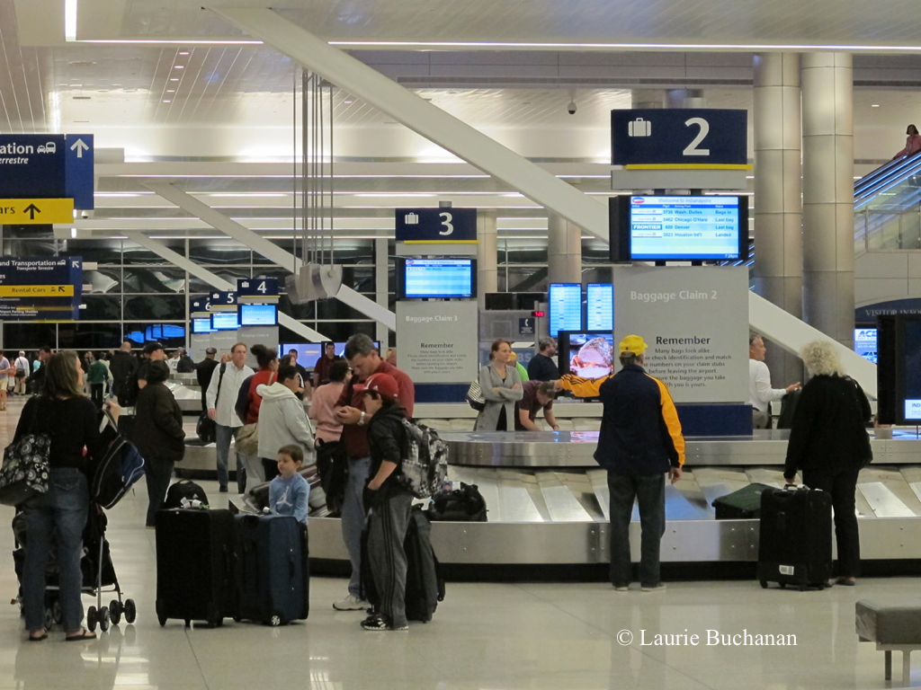
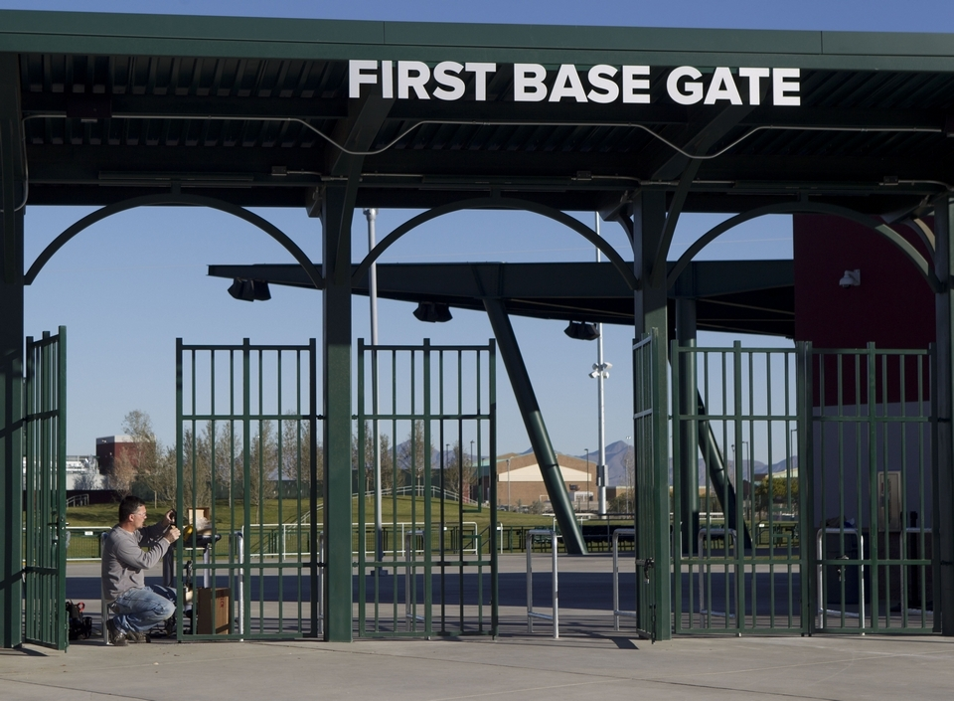
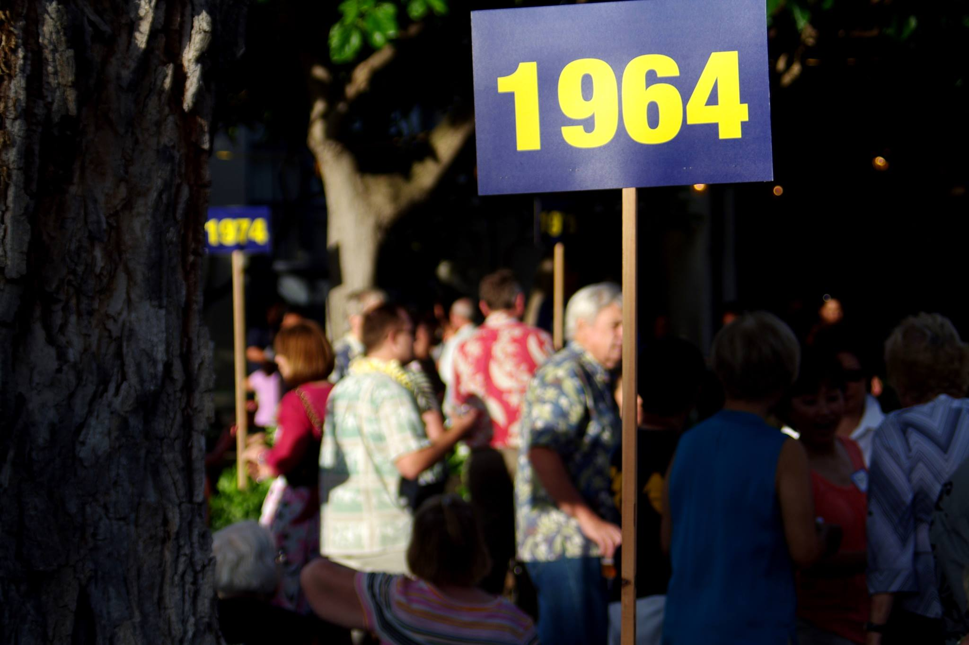
Analogy
Should everyone use the same door / gate / room / line?
  If not, should differentiation be based solely on protocol?
    If they can share, then they should share!
  Or should it be based on credentials?
    could it be as specific as connection?

Slide 18
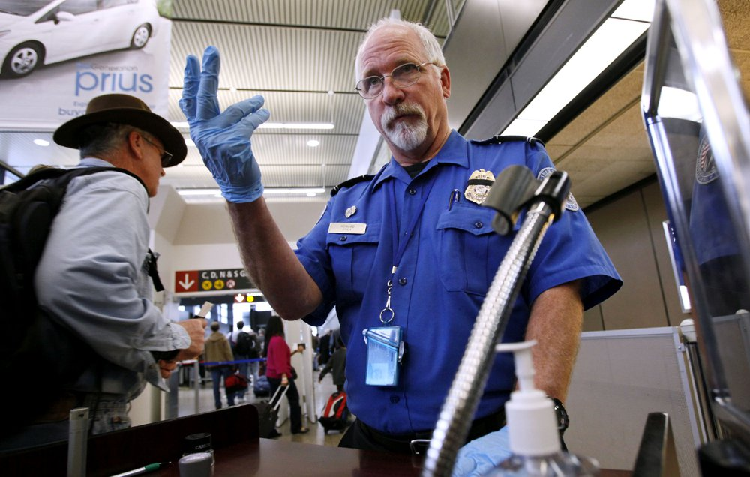
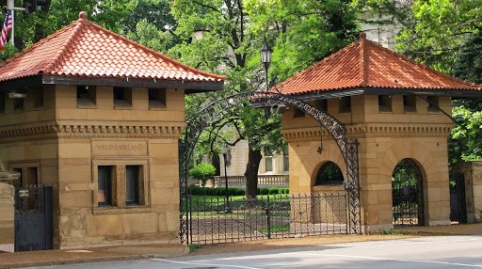
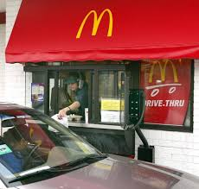

Actual Motivation
St. Louis private places
  Locked gate schedule
  Pattern known to residents
McDonald's drive through windows
Doctor's office examination rooms
  All downstream interactions are expected
  Literally, windowed whitelisting

